Slide 1
Showing Invision Patient Population Overlap – R model
-Neha Seth
05/25/2017

Slide 2
What : Patient Count Analysis done for FY 15-16
Why : To see VISUALLY which group has highest patient encounter data and their overlaps
INVISION
EMERGENCY
OUTPATIENT
INPATIENT
FY 15-16

Slide 3
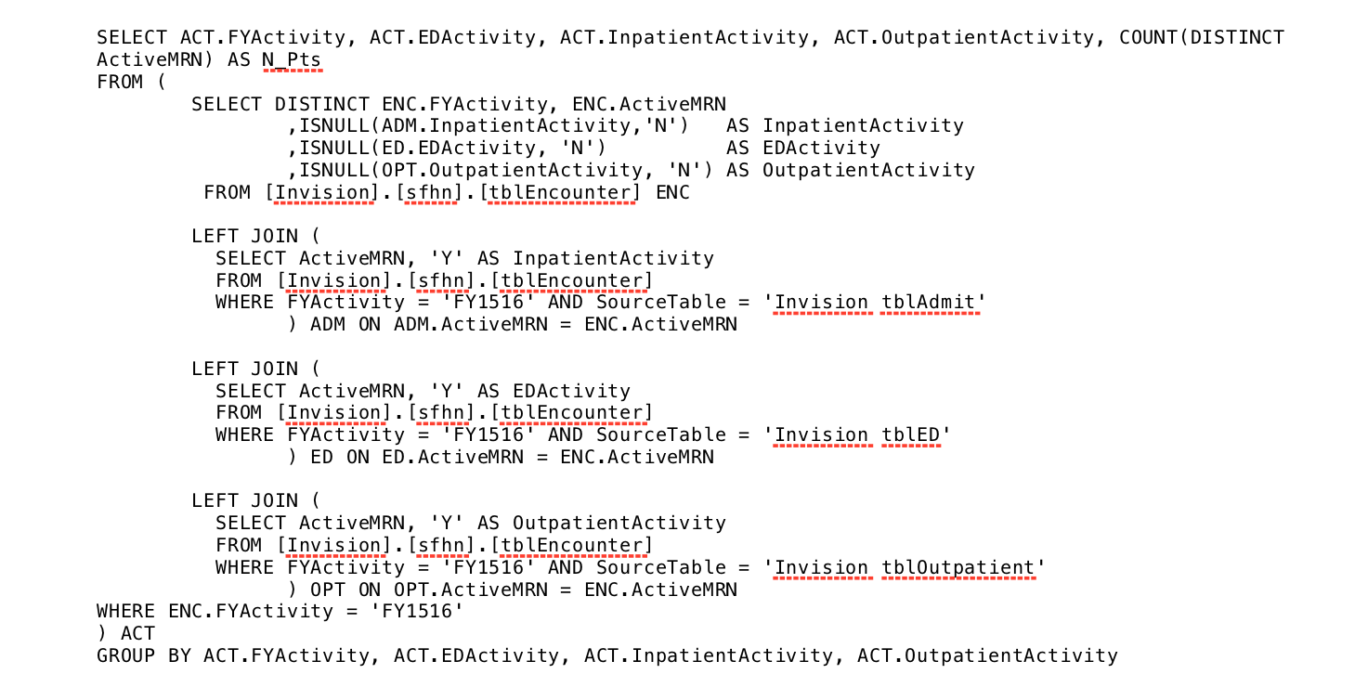
Tables/Query
Db – InReports-db01
[Invision].[sfhn].[tblEncounter]
Full Query – SharePoint Wiki Site - Intern Page
Backend – SQL query

Slide 4
SQL to Excel visualization
Visit Type | N_Pts | Percent
Emergency | 17733 | 15.4%
InPatient | 2737 | 2.4%
OutPatient | 67698 | 58.7%
OutPatients and Emergency | 15843 | 13.7%
InPatients and Emergency | 1063 | 0.9%
InPatients with OutPatient Services | 5749 | 5.0%
InPatients, Emergency, OutPatients | 4477 | 3.9%
Total | 115300 | 100.0%

Slide 5
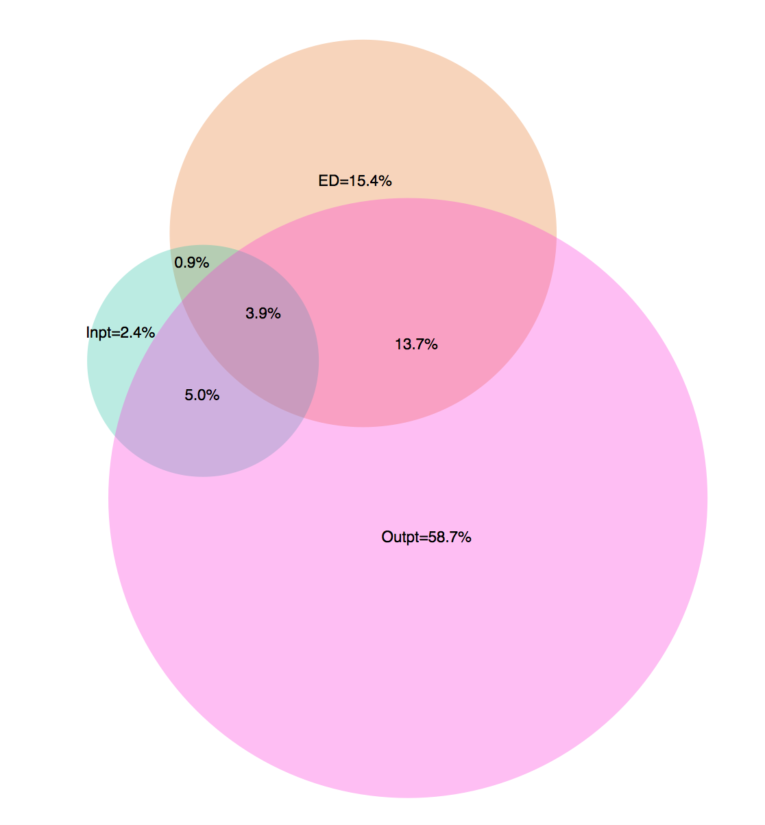
Tableau to R to – Venn Diagram to show overlap
Venn Diagram showing Invision Patient Data Count FY 15-16
All code and files are in SharePoint Wiki
Intern Page.
Only Outpatient
Only ED
Only Inpatient

Slide 6
